Slide 1

Collaborative Coding
Version Control with Rstudio/GitHub
Compscibio2023

Slide 2

Welcome!
Module expectations & conduct
Welcoming and supportive space for everyone regardless of background or identity: please use inclusive language
Show respect and appreciation for participants and facilitators
Accept constructive criticism with grace
Everyone has different levels of experience and everyone, including facilitators, has space to learn
Encourage questions
“No drop” module: speak up if you fall behind so we can help
Caption

Slide 3
Course Outline
Introductions
Concepts of version control and collaborative coding
Sign up for a GitHub account
Walk through and help installing/upgrading software
Rstudio/GitHub integration
Workflows for collaborative coding with version control
Practice working collaboratively on a (non-coding) project
Bonus: project management boards, issues, milestones

Slide 4
Systems Supported:
Systems that are supported:
Windows (honestly don’t know - a modern one?)
Mac OS 11 or higher
Systems that are not supported:
Older Windows systems (How old? Dunno)
Mac OS <11
Linux :(

Slide 5
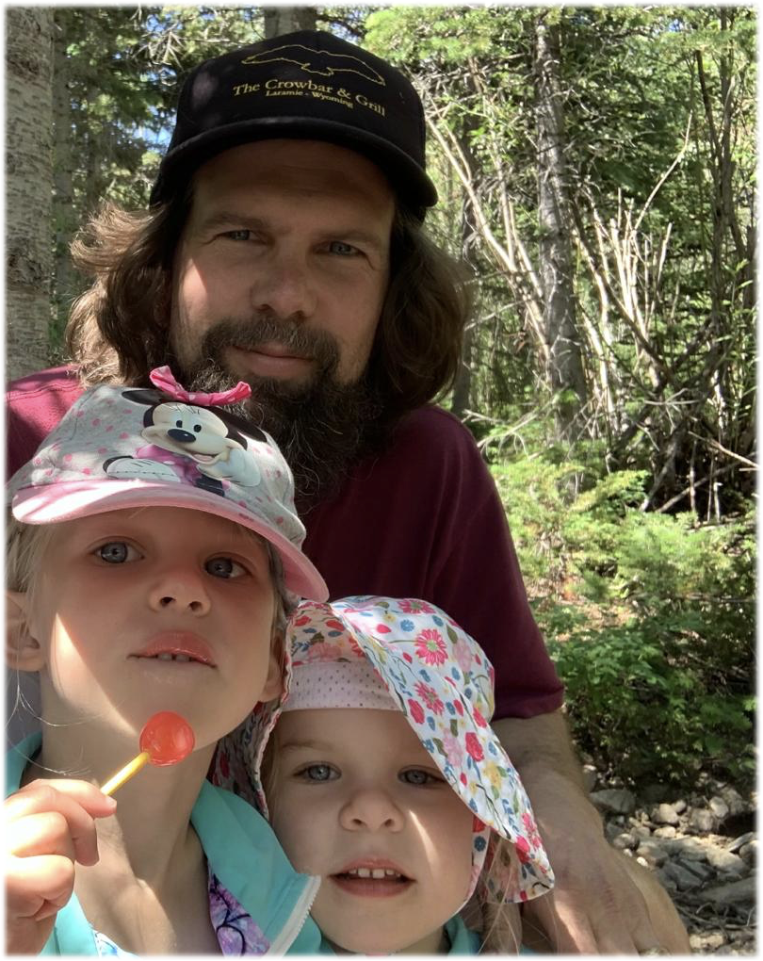
Rob Baker
Data Scientist/National Park Service
Formal education entirely biology (plant evolution, development, genetics, etc)
First introduced to R in 1999. But really… came kicking and screaming to R during my Ph.D.
GitHub user since 2013 . . . but similar trajectory: took a long time to really use it
Ex-Academic and currently work for the National Park Service in Colorado
Mainly develop in R, build tools for data management, metadata construction, etc (“NPSdataverse”)
Even as a “power user” of R and GitHub I only scratch the surface the capability/potential

Slide 6

Co-facilitators
Emma Girolami
Recent Miami grad - Spring of 2023!
Biology major
Currently works at Hueston Woods State Park

Slide 7

Co-Facilitators
Thad Deiss
Recently completed post-doctoral work at Uppsala University
Interests in the evolution of vertebrate adaptive immune systems (especially cartilaginous fish and bovids)

Slide 8
Introduce yourself
~30 seconds each
Name
Affiliation/what you do
Why you chose this module
What is your most frequently used emoji? (🙄)

Slide 9
Course Outline
Introductions
Concepts of version control and collaborative coding
Sign up for a GitHub account
Walk through and help installing/upgrading software
Rstudio/GitHub integration
Workflows for collaborative coding with version control
Practice working collaboratively on a (non-coding) project
Bonus: project management boards, issues, milestones

Slide 10
What is Version Control?
Version Control is the practice of tracking and managing changes (to software, code, documentation, etc)
You’re probably already using version control!
If you’ve ever used track changes in a word document or google doc, that’s a type of version control
If you’ve ever made changes and then saved your file so that you have files such as “final_draft1.docx”, “final_draft2.docx” that is also version control

Slide 11

So why use GitHub for version control?
Cons:
It isn’t easy to set up
It’s a very different way of thinking about how you work
Will require re-engineering how you save your code
Substantial learning curve: can be painful!
Pros:
Very easy to share code and data with collaborators
Essentially provides a cloud backup and support for working from different computers
Easy to work collaboratively with colleagues on coding (or other!) projects
Code and data can be publicly available for publication purposes
It’s easy to get wrong - but it’s hard to do something unrecoverable
Project management tools can be built in
Caption

Slide 12

So why use GitHub for version control?
Cons:
It isn’t easy to set up
It’s a very different way of thinking about how you work
Will require re-engineering how you save your code
Substantial learning curve: can be painful!
Pros:
Very easy to share code and data with collaborators
Essentially provides a cloud backup and support for working from different computers
Easy to work collaboratively with colleagues on coding (or other!) projects
Code and data can be publicly available for publication purposes
It’s easy to get wrong - but it’s hard to do something unrecoverable
Project management tools can be built in
Caption

Slide 13
What is a Repository?
“Repo”
Repository - a collection of files that are managed in a structured way
These can be static - think of something like data archives or a collection of previously published journal articles
JSTOR
Dryad
Or they can be dynamic - these files are subject to change, updates, edits, and versions. We will primarily be dealing with dynamic repositories. These are kind of like DropBox or GoogleDrive or OneDrive but much better!
GitHub
BitBucket
GitLab

Slide 14
Why GitHub?
Free!
Public or private repos
Advanced functionality (Issues, pull requests, automation, handles merging)
Great for R development (particularly if you want to develop packages!)
Fairly ubiquitous across academic, government, and industry institutions
(Yes you can and should put your GitHub account on your CV!)

Slide 15
Course Outline
Introductions
Concepts of version control and collaborative coding
Sign up for a GitHub account
Walk through and help installing/upgrading software
Rstudio/GitHub integration
Workflows for collaborative coding with version control
Practice working collaboratively on a (non-coding) project
Bonus: project management boards, issues, milestones

Slide 16

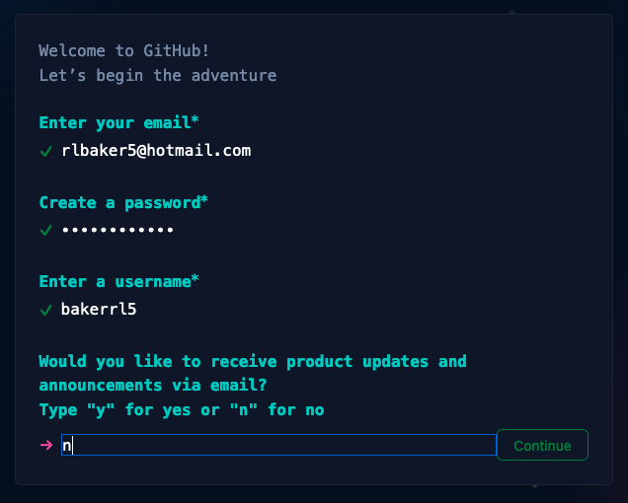

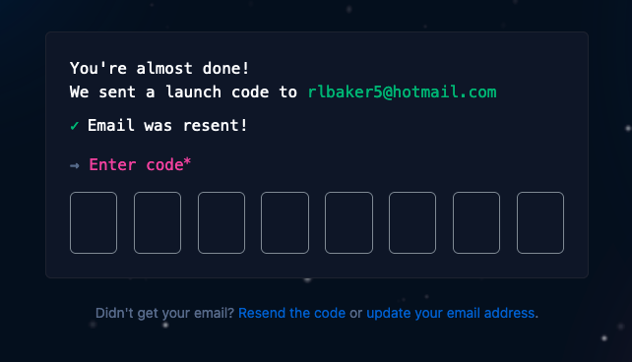
Set up:
Get a GitHub account (Step 1 of 4)
Go to https://github.com
Click “sign up” in the top right corner
Supply Email & password
Username can be changed later
Click Create Account
Enter code sent to your email

Slide 17
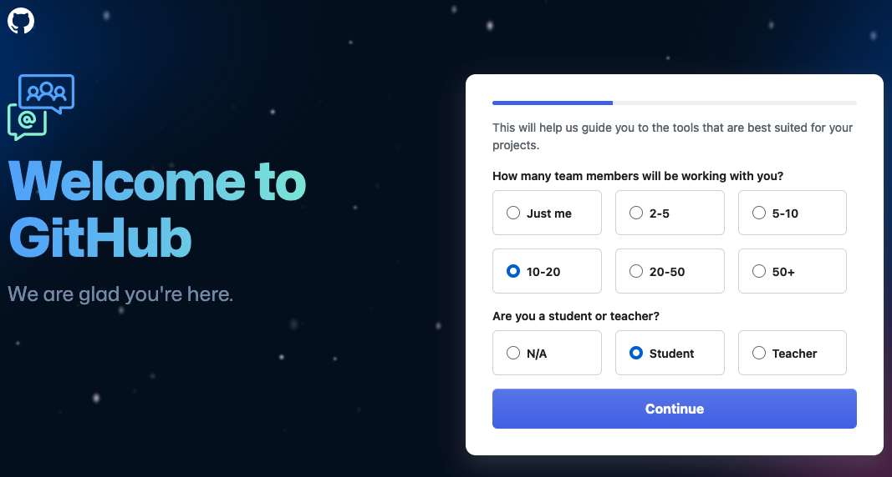
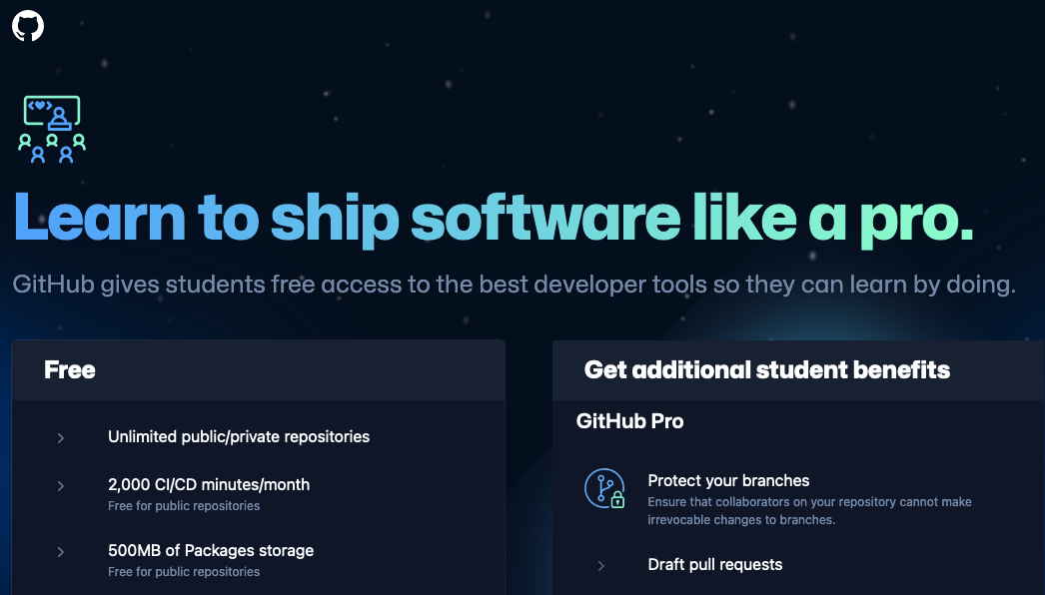
Set up
Get a GitHub account (Step 1 of 4)
Fill out the Welcome questions. Not sure this really matters that much.
Scroll down and select the Free version! (unless you don’t like your money)

Slide 18
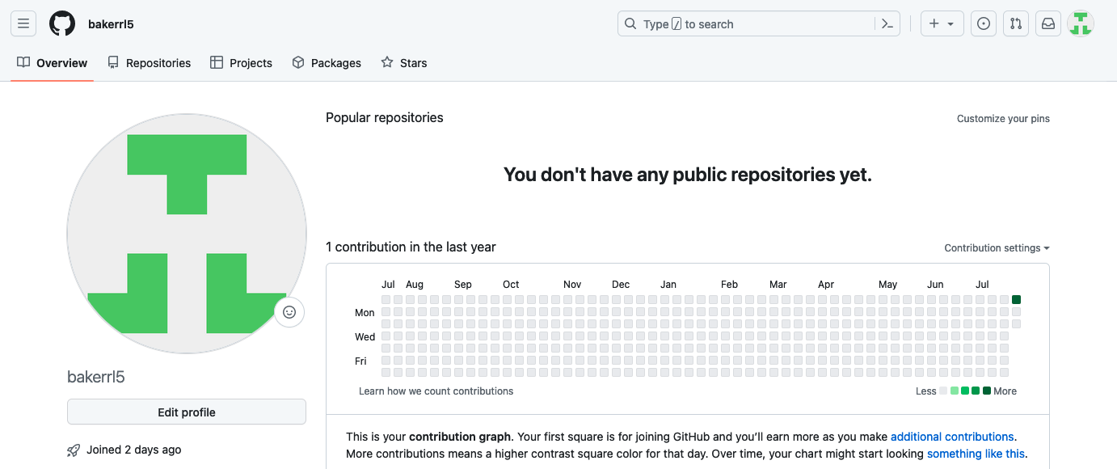
Set up
Get a GitHub account (Step 1 of 4)
We will pause here until
everyone is caught up

Slide 19
Course Outline
Introductions
Concepts of version control and collaborative coding
Sign up for a GitHub account
Walk through and help installing/upgrading software
Rstudio/GitHub integration
Workflows for collaborative coding with version control
Practice working collaboratively on a (non-coding) project
Bonus: project management boards, issues, milestones

Slide 20
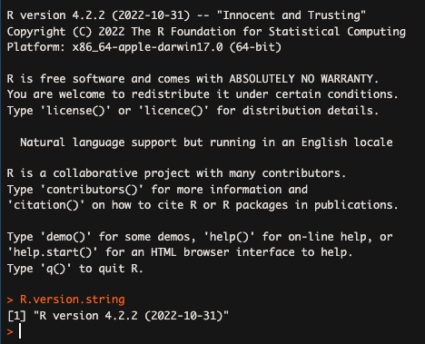
Set up
Get (or upgrade) R (step 2 of 4)
If you already have R:
Open R and see what version it is
Or type: >R.version.string to retrieve the version
If you have v4.3.1 (“Beagle Scouts”) you are ready to go
If not, follow along to upgrade
Oh no! My R version is out of date!

Slide 21
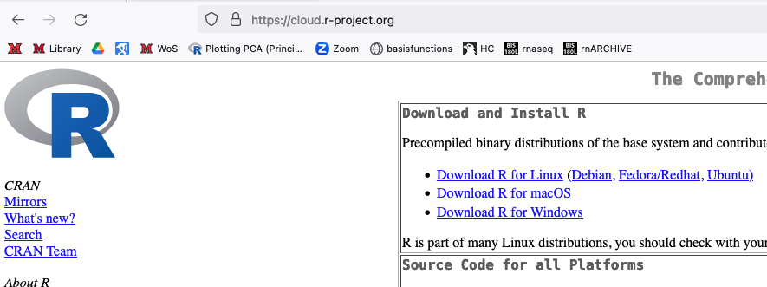
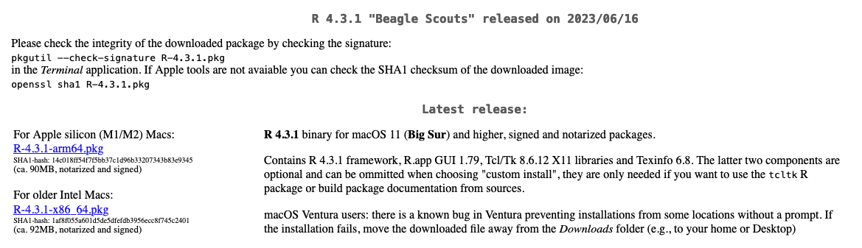
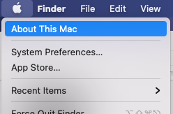
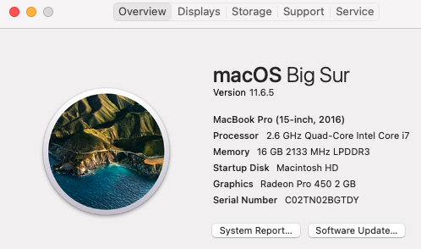
Set up
Get (or upgrade) R (step 2 of 4)
To install or upgrade go to: https://cloud.r-project.org
Click on the correct Download button for your operating system
Mac only: you will need to choose the installation for your processor
Mac only: To determine your processor, click on the Apple icon in the top left of your screen and choose “About this Mac”
Download R and install using all the defaults

Slide 22
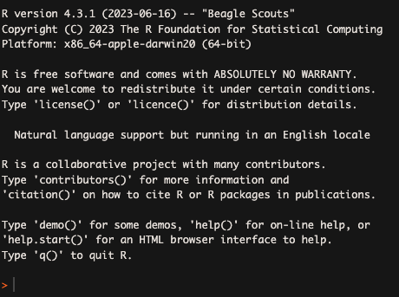
Set up
Get (or upgrade) R (step 2 of 4)
Check to make sure the install went well
Open R
Make sure it says:
“R version 4.3.1 (2023-06-16) — “Beagle Scouts”
We will pause here until
everyone is caught up

Slide 23
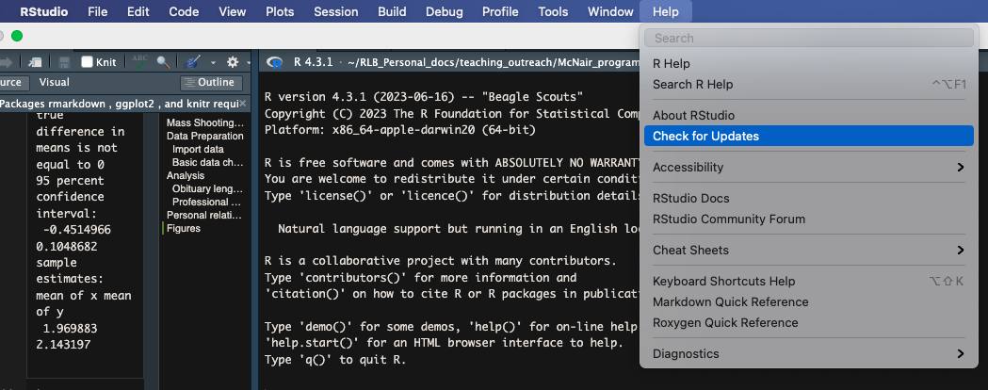
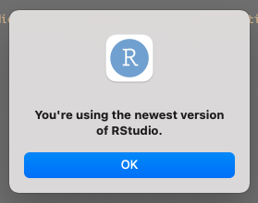
Set up
Get (or upgrade) Rstudio (step 3 of 4)
If you already have R studio, make sure you have the latest version.
Open Rstudio, go to the “Help” drop down menu at the top of the window
Select “Check for Updates”
If you have the latest version, you’re good to go!
If you see “Updated Available” follow along to update Rstudio.
Hey look, I have software that’s up to date! Who would have thought?

Slide 24
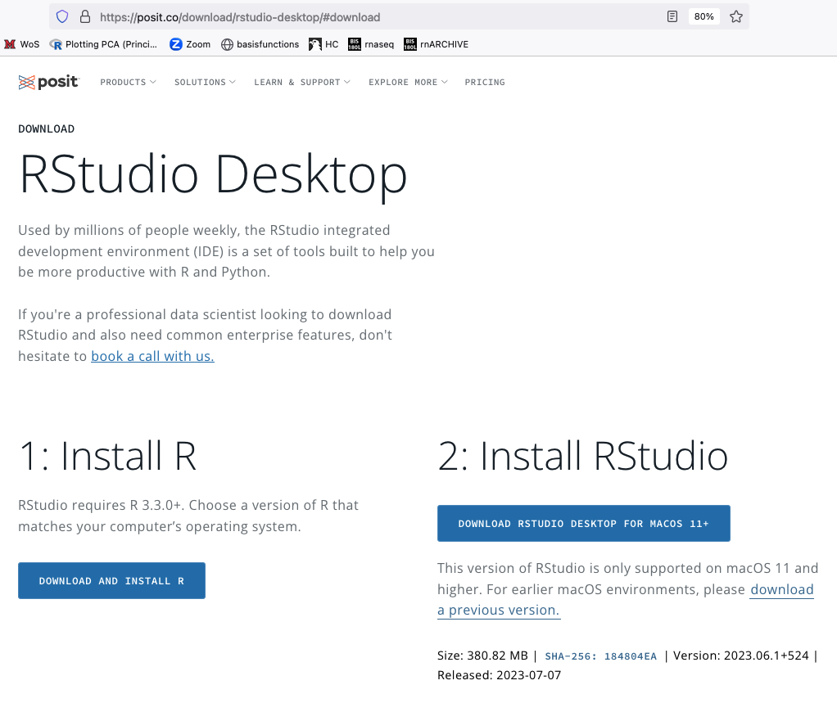
Set up
Get (or upgrade) Rstudio (step 3 of 4)
Go to: https://posit.co/download/rstudio-desktop/#download
Click “Download R Studio” (it will automatically detect your OS)
Install Rstudio using all the defaults.

Slide 25
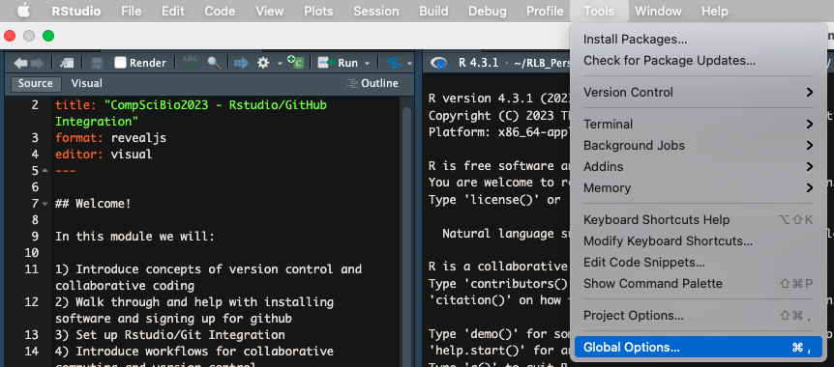
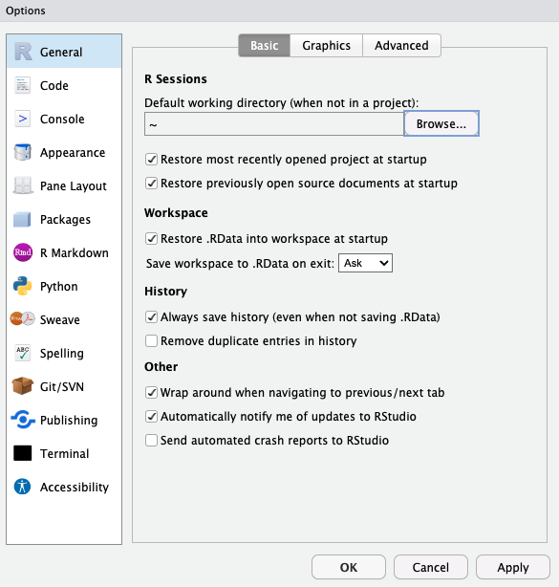
Set up
Get (or upgrade) Rstudio (step 3 of 4)
Open Rstudio
Make sure it is accessing the correct version of R (4.3.1)
If it is not, select “Global Options”
Click “Browse” and navigate to your newly installed version of R (4.3.1)
Click “Apply” (you may need to restart Rstudio too)
We will pause here until
everyone is caught up

Slide 26
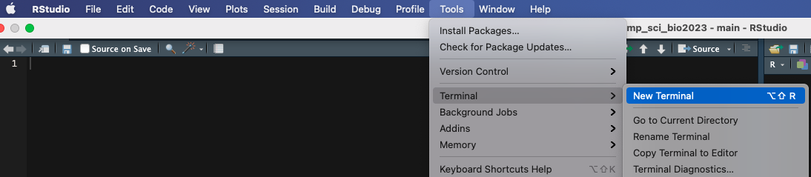
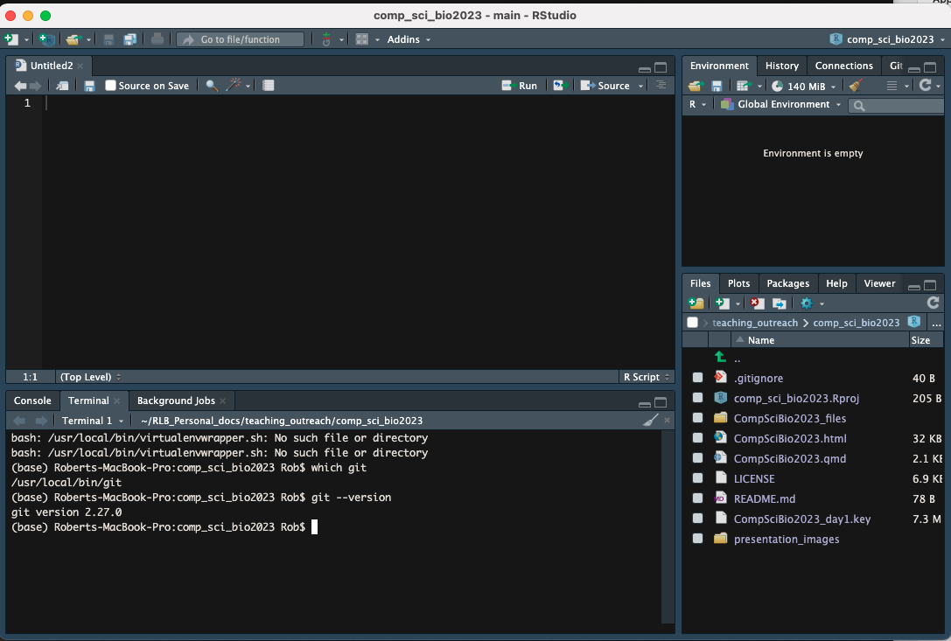
Set up
Get (or upgrade) Git (step 4 of 4)
Open Rstudio
Find the “Terminal” Window
Type: $ which git response: “/usr/bin/git”
Type: $ git --version response: “git version 2.41.0”
If you don’t have Git (response: “git: command not found”) or it is not version 2.41.0, follow along to install/upgrade

Slide 27
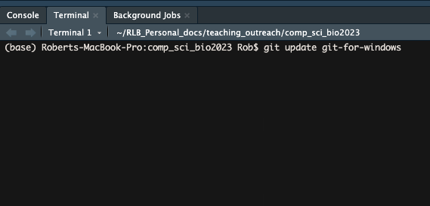
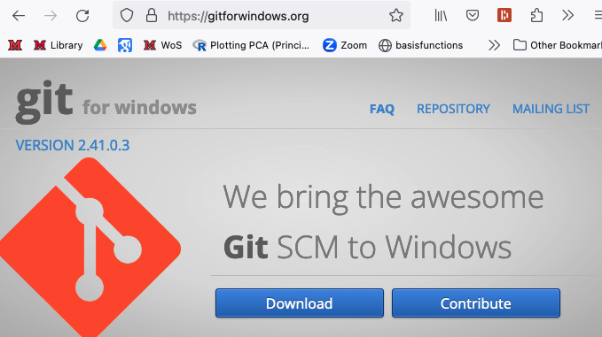

Set up
Get (or upgrade) Git (step 4 of 4)
WINDOWS: Upgrading Git
In the terminal, type: $ git update git-for-windows
WINDOWS: Git Initial Install
Go to https://gitforwindows.org
Click Download & Install:
When asked to “adjust your PATH environment”, select “Git from the command line and also from 3rd-party software”
Install in the default location

Slide 28
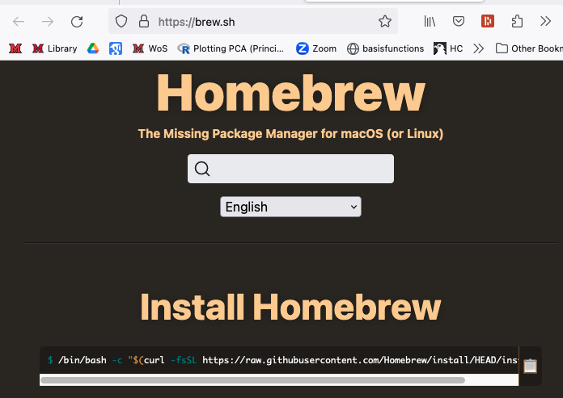
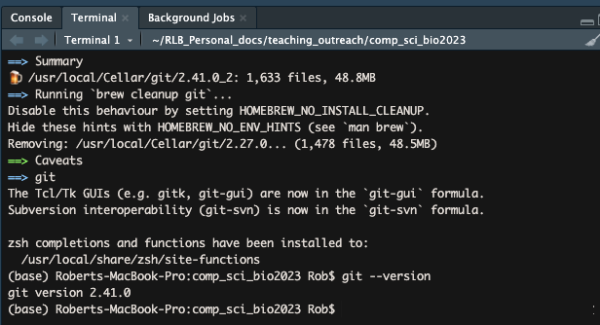
Set up
Get (or upgrade) Git (step 4 of 4)
MAC: Upgrade or Install Git
Install home-brew
Got to https://brew.sh
In the terminal, type: $ /bin/bash -c "$(curl -fsSL https://raw.githubusercontent.com/Homebrew/install/HEAD/install.sh)” (you can copy this from the brew.sh site)
Enter your password when prompted
Install git
In the Terminal type:
$ brew install git
Check that you have the updated version
$ git --version
We will pause here until
everyone is caught up

Slide 29
Course Outline
Introductions
Concepts of version control and collaborative coding
Sign up for a GitHub account
Walk through and help installing/upgrading software
Rstudio/GitHub integration
Version Control and Collaborative Coding Workflows
Practice working collaboratively on a (non-coding) project
Bonus: project management boards, issues, milestones

Slide 30
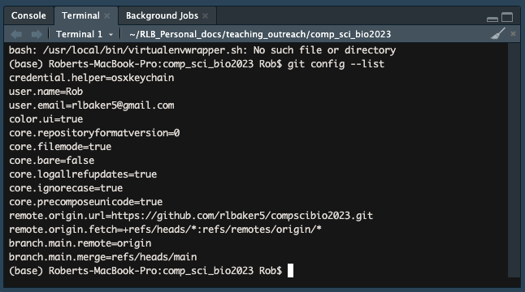
Rstudio/GitHub integration
Configure Git
From the Terminal pane in Rstudio run these four lines:
(For user.name and user.email use your GitHub username and email associated with your GitHub account)
git config --global user.name ‘rlbaker5’
git config --global user.email ‘rlbaker5@gmail.com'
git config --global --list
git config --global init.defaultBranch main

Slide 31
Rstudio/GitHub Integration
Get access to Git
You can use SSL or HTTPS
We will use HTTPS because it’s just easier
You can switch back and forth at any time if you choose

Slide 32
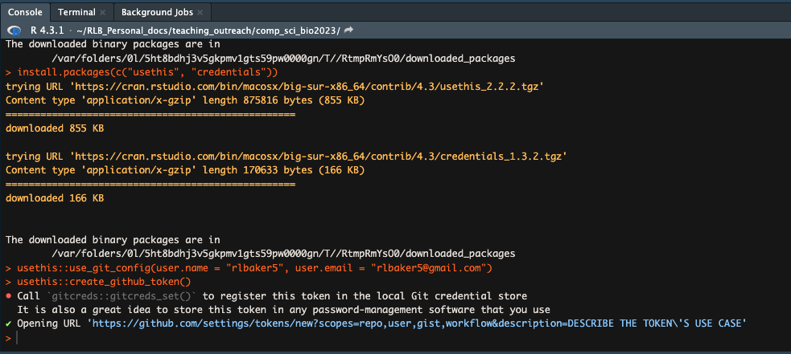
Rstudio/GitHub Integration
Get access to Git
From the Console in Rstudio run the following 3 lines of code:
>install.packages(c(“usethis”, “credentials”))
>usethis::use_git_config(user.name = “YourName”, user.email = “your@mail.com (Use your GitHub username and email address)
>usethis::create_github_token()
This should open a browser window for GitHub.com

Slide 33
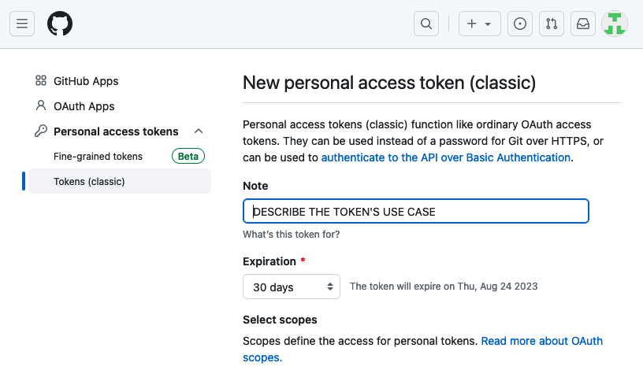
Rstudio/GitHub Integration
Get access to Git
After signing in, you will be brought to a “New personal access token (classic)” page
Describe the token (“compscibio2023”)
Set an expiration date
Use the default “Scopes”
Scroll down and click “Generate Token”

Slide 34
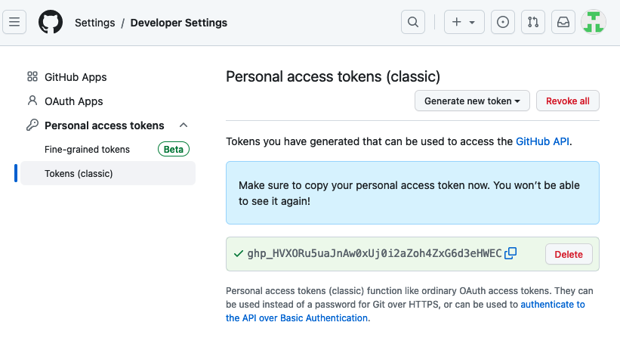
Rstudio/GitHub Integration
Get access to Git
Copy your personal access token (PAT) to your clipboard!
(Click the two linked squares next to the token)
somegArble_dee_gookZzZ

Slide 35
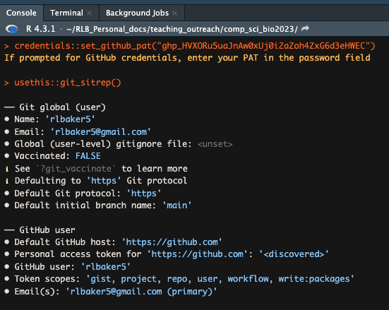
Rstudio/GitHub Integration
Get access to Git
Back in the Rstudio console….
>credentials::set_github_pat(“<paste_your_pat>”)
#don’t forget the “” around your PAT!
(If prompted, enter your password)
>usethis::git_sitrep()
somegArble_dee_gookIsmyPAaaat

Slide 36
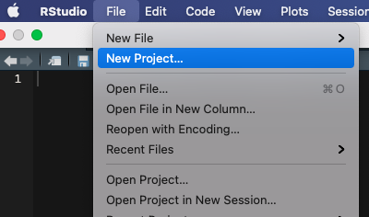
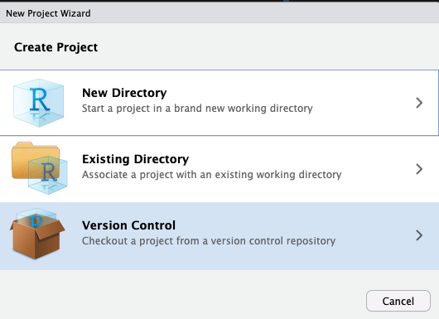
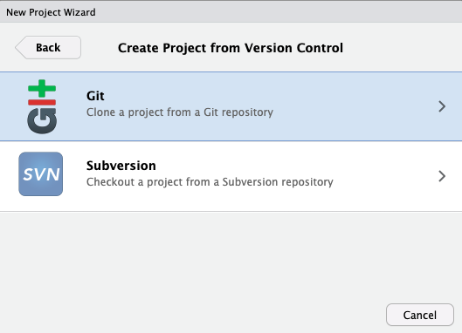
Rstudio/GitHub Integration
Get access to Git
Did it work?
In Rstudio go to File > New Project
If you see an option for Version Control, that is good!
Select “Version Control”
If you see an option to “Clone a project from a Git repository” that is good!

Slide 37
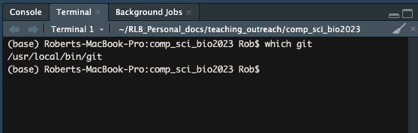
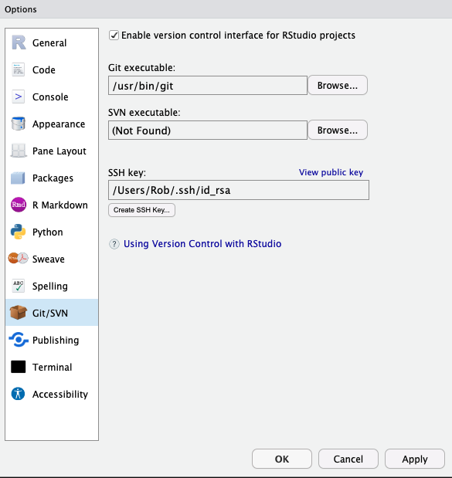
Rstudio/GitHub Integration
Get access to Git
Ruh-roh. It didn’t work . . . .
Quit and restart Rstudio. . . seriously, just do it. If that didn’t fix it. . .
Rstudio needs to be able to find git. Usually this is automatic, but you can do it manually. Find your git executable:
From the Terminal in Rstudio:
Windows: $ where git
Mac: $ which git
In Rstudio: Tools > Global Options > Git/SVN
Make sure the Git executable path points to your git executable file
Re-restart Rstudio if you made changes
Mac Example
Windows Example
Image credit: happygitwithr.com

Slide 38
Course Outline
Introductions
Concepts of version control and collaborative coding
Sign up for a GitHub account
Walk through and help installing/upgrading software
Rstudio/GitHub integration
Version Control and Collaborative Coding Workflows
Practice working collaboratively on a (non-coding) project
Bonus: project management boards, issues, milestones

Slide 39
Version Control
Working on your own project:
Start with a repository (typically remote)
Remote:
Main
v1

Slide 40
Version Control
Working on your own project:
Start with a repository (typically remote)
Remote:
Main
v1
Clone (or “pull”) the repository to local machine
Local:
Main
v1

Slide 41
Version Control
Working on your own project:
Start with a repository (typically remote)
Remote:
Main
v1
Clone (or “pull”) the repository to local machine
Local:
Main
v1
Commit
1
Commit
2
Commit
3
Work locally, making snapshots as you go (“commits”)

Slide 42
Version Control
Working on your own project:
Start with a repository (typically remote)
“Push” changes to your remote repository
Remote:
Main
v1
Remote:
Main
V2
Clone (or “pull”) the repository to local machine
Local:
Main
v1
Commit
1
Commit
2
Commit
3
Work locally, making snapshots as you go (“commits”)

Slide 43
Version Control
Working on your own project:
Start with a repository (typically remote)
“Push” changes to your remote repository
Remote:
Main
v1
Remote:
Main
V2
Clone (or “pull”) the repository to local machine
GitHub now reflects most recent snapshot & all commits
Local:
Main
v1
Commit
1
Commit
2
Commit
3
Work locally, making snapshots as you go (“commits”)

Slide 44
Version Control
Working on your own project:
Start with a repository (typically remote)
“Push” changes to your remote repository
Remote:
Main
v1
Remote:
Main
v1
Remote:
Main
v1
Remote:
Main
V2
Clone (or “pull”) the repository to local machine
GitHub now reflects most recent snapshot & all commits
Local:
Main
v1
Commit
1
Commit
2
Commit
3
Remote repository available throughout development
Work locally, making snapshots as you go (“commits”)

Slide 45
Version Control
Working on your own project:
Start with a repository (typically remote)
“Push” changes to your remote repository
Remote:
Main
v1
Remote:
Main
v1
Remote:
Main
v1
Remote:
Main
V2
Clone (or “pull”) the repository to local machine
GitHub now reflects most recent snapshot & all commits
Local:
Main
v1
Commit
1
Commit
2
Commit
3
Remote repository available throughout development
Work locally, making snapshots as you go (“commits”)
Version Control: commit history maintained; changes to be rolled back

Slide 46
Collaborative Coding
Forking Workflow
Lightweight, relatively easy
Highlight your own work on your own GitHub account
Safe! You aren’t changing anything on the main repo until you’re really ready; you can test it out after upload
Can request code reviews, etc before your changes get incorporated into the main repo

Slide 47
Collaborative Coding
Forking Workflow
Remote Main v1 - might not be your repo (maybe a lab repo?)
“Fork” the lab repo to a repo to create a copy on your own GitHub account
Clone (or pull) your development fork to your local machine
Remote:
Main
v1
Remote:
Dev.
Fork
Local:
Dev.
Fork

Slide 48
Collaborative Coding
Forking Workflow
Remote Main v1 - might not be your repo (maybe a lab repo?)
“Fork” the lab repo to a repo to create a copy on your own GitHub account
Clone (or pull) your development fork to your local machine
Remote:
Main
v1
Remote:
Main
v1
Remote:
Main
v1
Remote:
Dev.
Fork
Local:
Dev.
Fork
Commit
1
Commit
2
Commit
3

Slide 49
Collaborative Coding
Forking Workflow
Initiate a “Pull request”: ask that someone incorporate your changes to the lab account (NOT a PULL)
“Push” your changes to the Forked copy of the repo on your own GitHub account
Make your edits (“commits”) locally as before
Remote Main v1 - might not be your repo (maybe a lab repo?)
“Fork” the lab repo to a repo to create a copy on your own GitHub account
“Clone” (or “Pull”) your development fork to your local machine
Remote:
Main
v1
Remote:
Main
v1
Remote:
Main
v1
Remote:
Dev.
Fork
Remote:
Dev Fork
V2
Local:
Dev.
Fork
Commit
1
Commit
2
Commit
3

Slide 50
Collaborative Coding
Forking Workflow
Initiate a “Pull request”: ask that someone incorporate your changes to the lab account (NOT a PULL)
“Push” your changes to the Forked copy of the repo on your own GitHub account
Make your edits (“commits”) locally as before
Remote Main v1 - might not be your repo (maybe a lab repo?)
“Fork” the lab repo to a repo to create a copy on your own GitHub account
“Clone” (or “Pull”) your development fork to your local machine
Remote:
Main
v1
Remote:
Main
v1
Remote:
Main
v1
Remote:
Main
V2
Remote:
Dev.
Fork
Remote:
Dev Fork
V2
Local:
Dev.
Fork
Commit
1
Commit
2
Commit
3

Slide 51
Collaborative Coding
Forking Workflow
User Two
Remote:
Dev Fork
v1.2
Remote Main v1 - might not be your repo (maybe a lab repo?)
“Fork” the lab repo to a repo to create a copy on your own GitHub account
“Clone” (or “Pull”) your development fork to your local machine
Remote:
Main
v1
Remote:
Main
v1.2
Remote:
Main
v1.2
“Push” your changes to the Forked copy of the repo on your own GitHub account
Make your edits (“commits”) locally as before
Remote:
Dev Fork
v1
Remote:
Dev Fork
v2
Local:
Dev Fork
v1
Commit
1
Commit
2
Commit
3
User One

Slide 52
Collaborative Coding
Forking Workflow
User Two
Remote:
Dev Fork
v1.2
Initiate a “Pull request”: ask that someone incorporate your changes to the lab account (NOT a PULL)
“Push” your changes to the Forked copy of the repo on your own GitHub account
Make your edits (“commits”) locally as before
Remote Main v1 - might not be your repo (maybe a lab repo?)
“Fork” the lab repo to a repo to create a copy on your own GitHub account
“Clone” (or “Pull”) your development fork to your local machine
Remote:
Main
v1
Remote:
Main
v1.2
Remote:
Main
v1.2
Remote:
Main
V1.3
Remote:
Dev Fork
v1
Remote:
Dev Fork
v2
Local:
Dev Fork
v1
Commit
1
Commit
2
Commit
3
User One

Slide 53
Collaborative Coding
Local:
Dev Fork
v1.2
Forking Workflow
Commit
1
Commit
2
User Two
Remote:
Dev Fork
v1.2
Remote:
Dev Fork
v1.2
Remote:
Main
v1
Remote:
Main
v1.2
Remote:
Main
v1.2
Remote:
Dev Fork
v1
Remote:
Dev Fork
v2
Local:
Dev Fork
v1
Commit
1
Commit
2
Commit
3
User One

Slide 54
Collaborative Coding
Local:
Dev Fork
v1.2
Forking Workflow
Commit
1
Commit
2
User Two
Remote:
Dev Fork
v1.2
Remote:
Dev Fork
v1.2
Remote:
Main
v1
Remote:
Main
v1.2
Remote:
Main
v1.2
Remote:
Main
V1.3
Remote:
Dev Fork
v1
Remote:
Dev Fork
v2
Local:
Dev Fork
v1
Commit
1
Commit
2
Commit
3
User One

Slide 55
Collaborative Coding
Local:
Dev Fork
v1.2
Forking Workflow
Commit
1
Commit
2
User Two
Remote:
Dev Fork
v1.2
Remote:
Dev Fork
v1.2
Remote:
Dev Fork
v1.4
Remote Main v1 - might not be your repo (maybe a lab repo?)
“Fork” the lab repo to a repo to create a copy on your own GitHub account
“Clone” (or “Pull”) your development fork to your local machine
Remote:
Main
v1
Remote:
Main
v1.2
Remote:
Main
v1.2
Remote:
Main
V1.3
Remote:
Main
V1.5
Remote:
Dev Fork
v1
Remote:
Dev Fork
v2
Local:
Dev Fork
v1
Commit
1
Commit
2
Commit
3
User One

Slide 56
Collaborative Coding
Local:
Dev Fork
v1.2
Forking Workflow
Commit
1
Commit
2
User Two
Remote:
Dev Fork
v1.2
Remote:
Dev Fork
v1.2
Remote:
Dev Fork
v1.4
Remote:
Main
v1
Remote:
Main
v1.2
Remote:
Main
v1.2
Remote:
Main
V1.3
Remote:
Main
V1.5
Remote:
Main
V1.5
Remote:
Main
V1.5
Remote:
Dev Fork
v1
Remote:
Dev Fork
v2
Remote:
Dev Fork
1.5
Local:
Dev Fork
v1
Commit
1
Commit
2
Commit
3
Local:
Dev Fork
1.5
Commit
1
User One

Slide 57
Collaborative Coding
Local:
Dev Fork
v1.2
Forking Workflow
Commit
1
Commit
2
Remote:
Dev Fork
v1.2
Remote:
Dev Fork
v1.2
Remote:
Dev Fork
v1.4
Two (or more) users can simultaneously collaborate on the same project
The main branch is always available to the public
Multiple different development forks can be worked on simultaneously
Remote:
Main
v1
Remote:
Main
v1.2
Remote:
Main
v1.2
Remote:
Main
V1.3
Remote:
Main
V1.5
Remote:
Main
V1.5
Remote:
Main
V1.5
Remote:
Dev Fork
v1
Remote:
Dev Fork
v2
Remote:
Dev Fork
1.5
Local:
Dev Fork
v1
Commit
1
Commit
2
Commit
3
Local:
Dev Fork
1.5
Commit
1

Slide 58
Version Control And Collaborative Coding
Terminology
Repository (repo) - managed collection of files
Version Control - keeping track of changes in files
Fork - create a copy of a repo on a different account
Branch - A new line of development; may be on a different repo or account (result of a Fork) or may be in the same repo.
Clone - create a copy of a repo on a local machine
Pull - pull all the changes from a repo to your local machine
Commit - a versioned change, with a comment
Push - move all the commits to your branch
Pull Request - Request that your (modified) Forked branch be incorporated into a the main branch
Merge - the process of reconciling two branches upon a Push or a Pull Request
Merge conflict - when the two branches cannot automatically be reconciled and must be manually adjusted

Slide 59
Course Outline
Introductions
Concepts of version control and collaborative coding
Sign up for a GitHub account
Walk through and help installing/upgrading software
Rstudio/GitHub integration
Version Control and Collaborative Coding Workflows
Practice: collaborative version control
Bonus: project management boards, issues, milestones

Slide 60
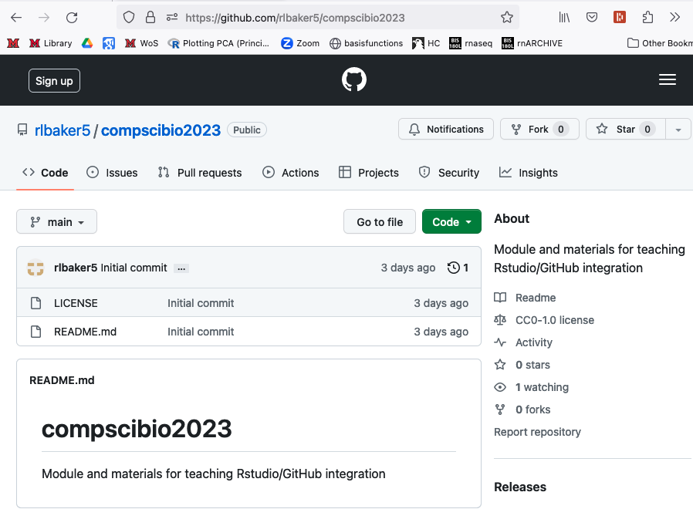
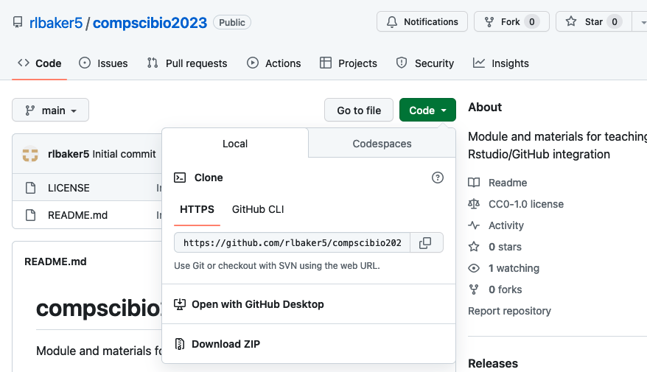
Practice: collaborative version control
Fork a Repo
Log in to your GitHub.com account
Navigate to: GitHub.com/rlbaker5/compscibio2023
Fork the repo to your own account
Navigate to your own profile and enter the newly forked repo (github.com/<username>/compscibio2023)
Use the green “Code” drop-down to copy the URL by clicking on the interlocking squares

Slide 61
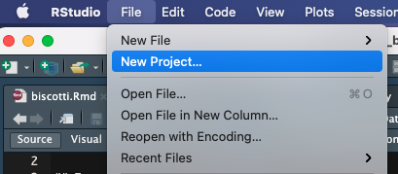

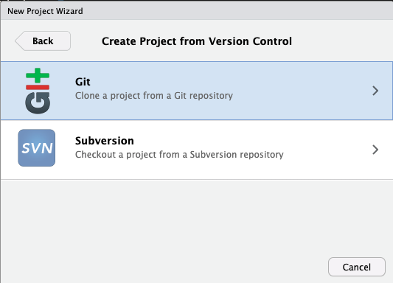
Practice: collaborative version control
Clone a Repo
Open Rstudio
Using From the “File” drop-down menu, select “New Project”
Select “Version Control”
Then choose “Git (“clone a project from a Git repository”)

Slide 62
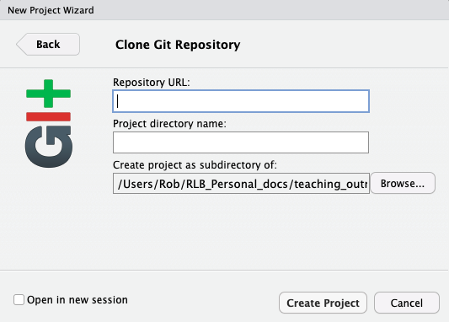
Practice: collaborative version control
Clone a Repo
Paste in the repo URL
Give your project a name (e.g. “compscibio2023_dev”)
Select a location where you want the project to live on your hard drive
Click “Create Project”

Slide 63
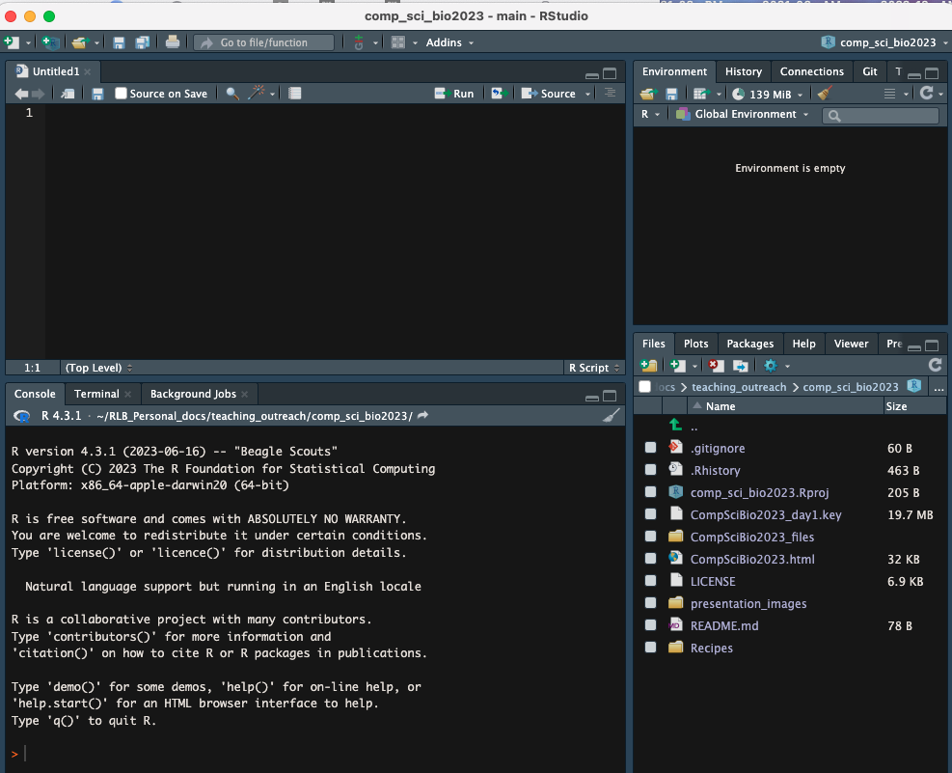
Practice: collaborative version control
Clone a Repo
Your Rstudio should look some thing like this (probably with a different color scheme)
But notice all the files from the repo are now listed under Files and are now on your local machine!
(Your files may differ slightly from the ones shown here)

Slide 64
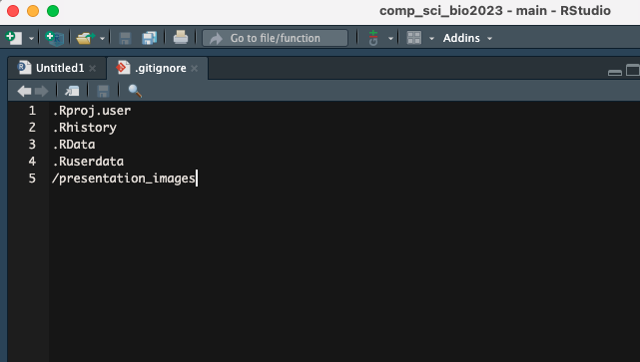
Practice: collaborative version control
.gitignore
All the changes you make will be pushed to your (public) repo.
There are likely files you don’t want to make public (don’t want to track via version control)
You can tell Git to ignore these files or folders by adding them to “.gitignore”
Click .gitignore to open it
Add some files to ignore. Good ones include .Rhistory and .xlsx

Slide 65
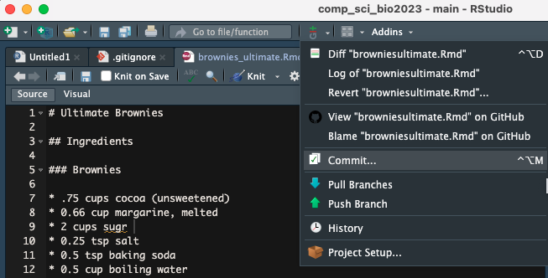
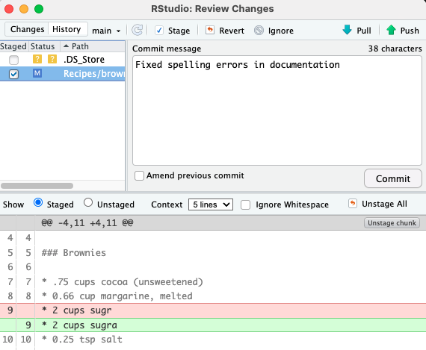
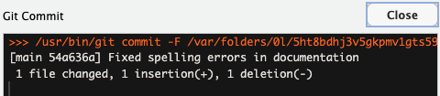
Practice: collaborative version control
Commits
In Rstudio, click on the “Git” drop down menu.
Select “Commit” and a new window will open up.
Select the file you changed and make sure to “stage” it by clicking the check box.
Enter a comment into the Commit Message pane and then click “Commit”
A new window will open with the results of your commit.
Best practices: commit often, document well.

Slide 66
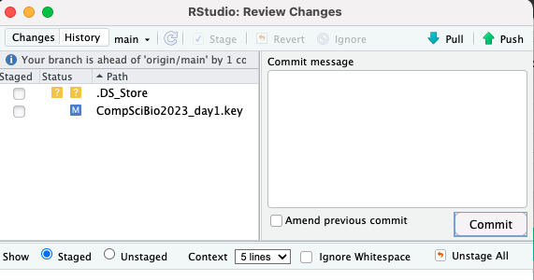
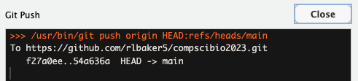
Practice: collaborative version control
Pushing to your GitHub repo
Close the “Git Commit” Window.
Notice that in the “Review Changes” Window your edited file is no longer listed (in my case I made changes to this keynote presentation and so it is listed)
Click the “Push” button to push your commits to your GitHub repo.
A new window pops up with the results of your Push.
Best practices: push occasionally (when you are done with your current work, or at the end of the day)

Slide 67
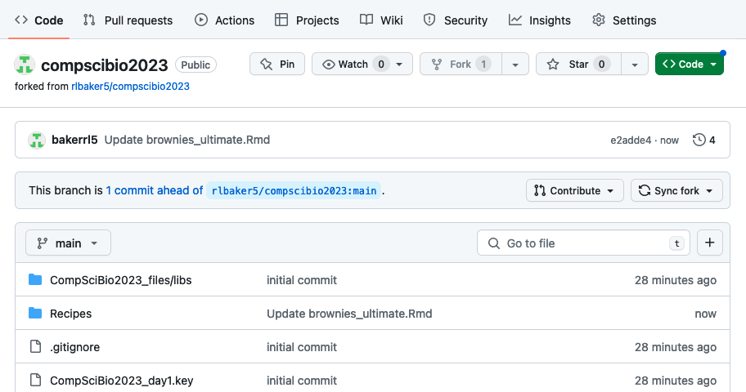
Practice: collaborative version control
Inspect your GitHub Repo
Navigate to your GitHub account and the repo you are working on
URL should look something like: GitHub.com/username/reponame
You should be able to see your time-stamped commit with your comment
You can also see that your “branch” is ahead of the main branch that it was forked from.
This is a great time to identify any mistakes, test out code, see if web pages and documentation render correctly, etc.

Slide 68
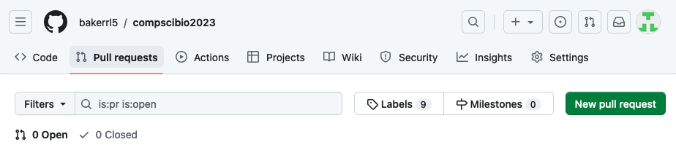
Practice: collaborative version control
Initiate a Pull Request
Now it’s time to (ask to) add your changes to the main repository (perhaps run by a lab manager?)
Click on “Pull Requests”, which will take you to a new page.
Click on “New Pull Request” to open yet another page.
It’s worth inspecting this page closely to make sure you’re dong what you meant to do….

Slide 69
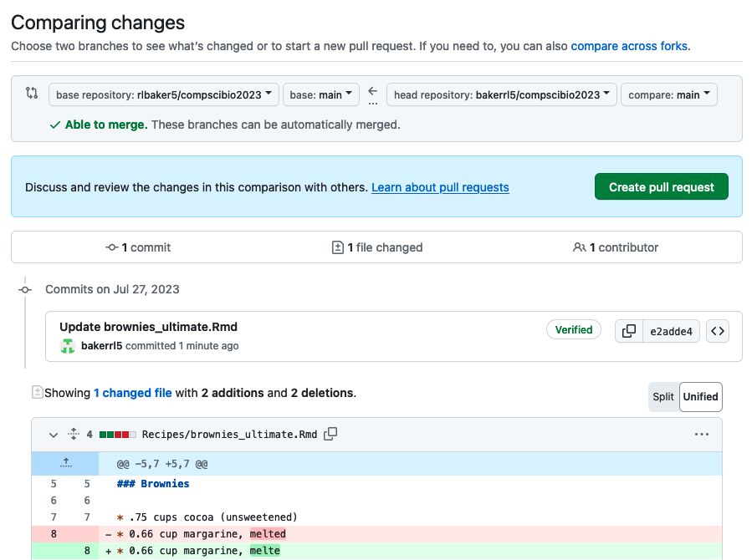
Practice: collaborative version control
Initiate a Pull Request
Check to make sure you are moving files FROM the right place and TO the right place
Hopefully GitHub tells you that the files can be merged automatically… (but if not, don’t worry)
Check that the files you wanted to change are the ones being changed
You can even inspect the specific changes (again)
When you’re happy, click “Create pull request”

Slide 70
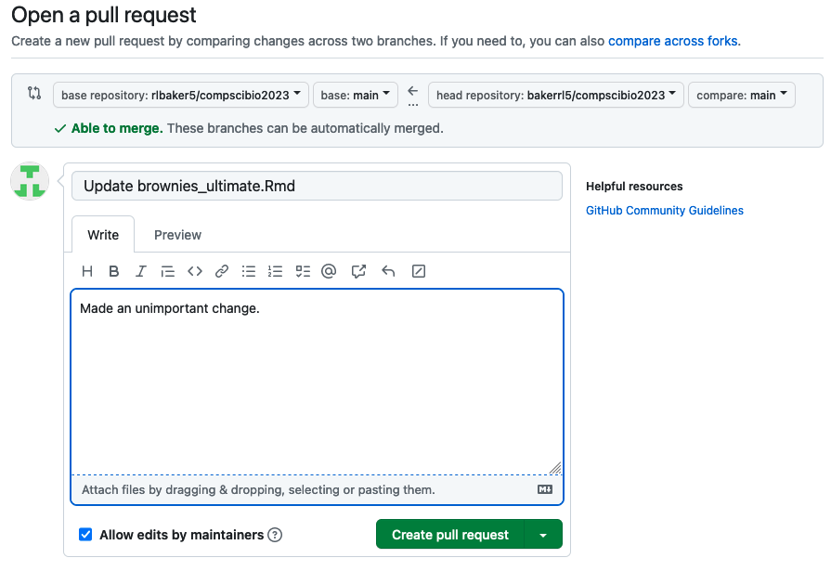
Practice: collaborative version control
Initiate a Pull Request
GitHub may have tried to give your Pull Request a title, which you can edit.
You can also add some helpful comments so that whoever is reviewing your Pull Request knows what you did (or tried to do)
Once you are happy, click “Create Pull Request”.
Whoever controls the main repository will be notified that you want to merge in changes.
You can’t delete the Pull Request! However, you can still add more comments or you can close it.
Best practices: open Pull Requests infrequently and only when your are done with whatever task you were working on (or if you need to hot-fix a bug!).
Best practices: Pull Requests can also be a great way of asking for a code review, even if you’re not quite ready to merge into main.

Slide 71
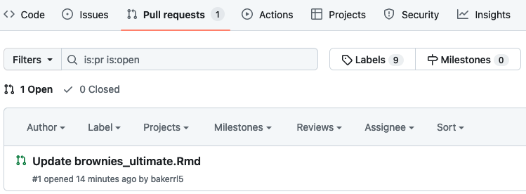


Practice: collaborative version control
What happens to your Pull Request?
Whoever has access to the repo you requested your changes be pulled into gets notified that there is an open Pull Request.
They can examine your PR, look at specific changes you made, and can comment on it to request clarification or approve the changes.
They can ignore it, close it, or merge it it in (at which point it automatically closes)

Slide 72


Practice: collaborative version control
What Next?
If your PR gets merged, there is a little maintenance you need to do to on your end:
Go to your fork of the repo on GitHub and sync it to the main repo (notice the “merge” counts as a commit so your forked repo is already behind the main repo by 1 commit!)
In Rstudio, go to the Git tab and select “Pull” to pull down any changes and update your local copy.
Any time you start to work on a project you should sync it and then pull it. Don’t just open Rstudio and start working!

Slide 73


Practice: collaborative version control
Merge Conflicts: here be dragons!
If multiple people are each working on different files, Git/GitHub can automatically merge the changes
If multiple people are working on different lines within the same file, Git/GitHub can automatically handle the merge
Merge Conflict: multiple people work on the same line in the same file generates a Merge Conflict that must be manually resolved.

Slide 74


Practice: collaborative version control
Resolving Merge Conflicts
Best Case Scenario: merge conflicts are simple and can be resolved via GitHub web page.
The merge conflicts are identified; delete the rows you want to remove and delete the indicators.
Click “Mark Resolved”; Commit the merge.
Merge the Pull Request. Done!

Slide 75
Practice: collaborative version control
Complicated merge conflicts:
The best way to fix them is avoid them: communicate with your collaborators!
Require editing off-line, but the concept is the same: delete what you don’t want and keep what you do
Additional issues can arise if you aren’t careful
Its hard to screw up so badly it’s not recoverable
Most mistakes can be fixed after some googling
Complex problems are beyond the scope of this module

Slide 76
Course Outline
Introductions
Concepts of version control and collaborative coding
Sign up for a GitHub account
Walk through and help installing/upgrading software
Rstudio/GitHub integration
Version Control and Collaborative Coding Workflows
Practice: collaborative version control
Bonus: project management boards, issues, milestones

Slide 77


GitHub project management
Projects
Projects are a nice way to keep track of your repo (or even many repos at once): what needs to be done, what is in progress, what has been done.
I like “Boards” view, but super customizable
You can customize the columns and add “issues” to each.

Slide 78


GitHub project management
Milestones
Milestones are a way of grouping issues
You can break problems down into multiple issues, then assign them to a milestone
Milestones help you keep track of progress towards a larger objective

Slide 79

GitHub project management
Advanced examples: Project Boards

Slide 80
GitHub project management
Advanced examples: Github Pages

Slide 81
Credits and additional info
Happy Git with R: https://happygitwithr.com/ (you may notice we followed this very closely!)
Posit Version control: https://support.posit.co/hc/en-us/articles/200532077
Configuring R/GitHub: https://gist.github.com/z3tt/3dab3535007acf108391649766409421
Data Carpentries Workshops: https://datacarpentry.org/
Various amounts of googling!

